Slide 1


Slide 2
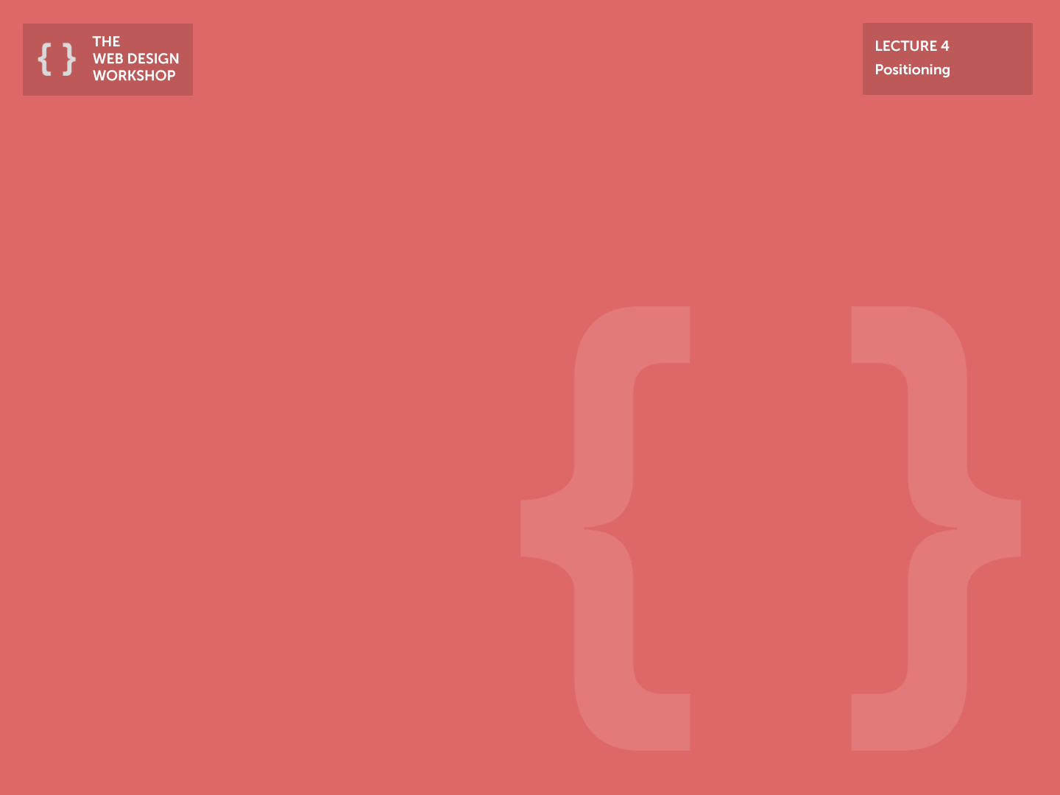
Announcements
Grades ~ 80% ready
Did not take into account excused absences
Let us know if you find any errors
< 75 is in danger of failing
Final Project Check-in this weekend
Please fill out the form if you haven’t already!
Extra Topics Lectures:
Introduction to Backend Web Development (Probably Django)
Deploying your website via Github

Slide 3
Today
A tutorial on some of the popular user interface elements
Popover & Tooltips
Masonry
Sticky Nav
Think of it as a recap of Jquery lectures
Hands-on focused lecture!

Slide 4
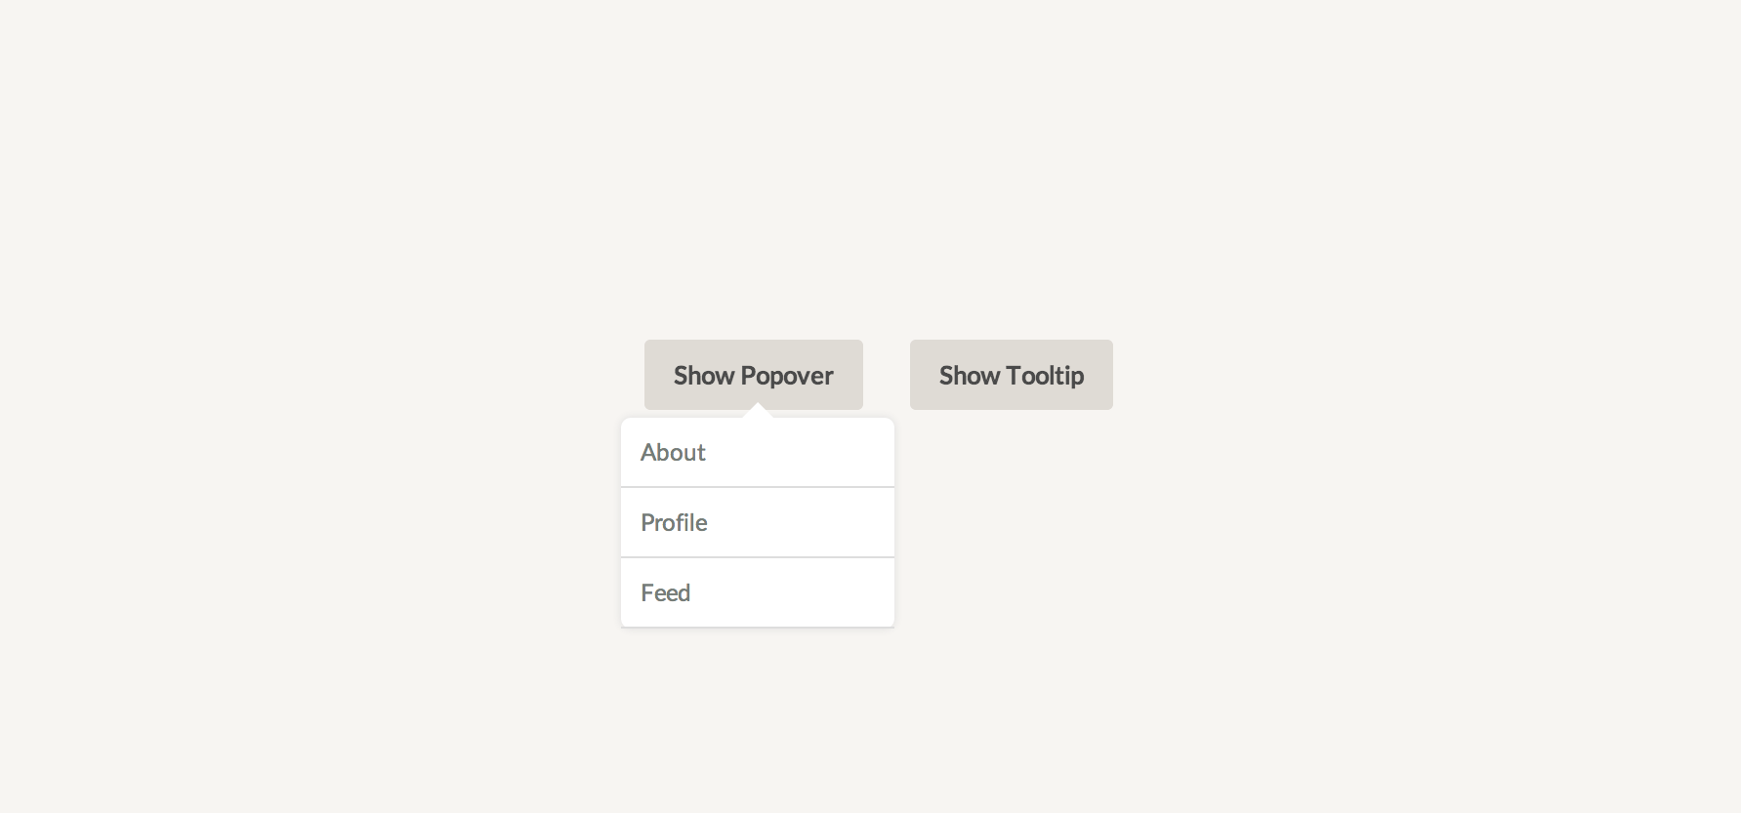
Popover
Used to convey additional information upon user request
Variation of a dropdown menu
Respond to click or a hover event
Example: Facebook user profile popovers

Slide 5
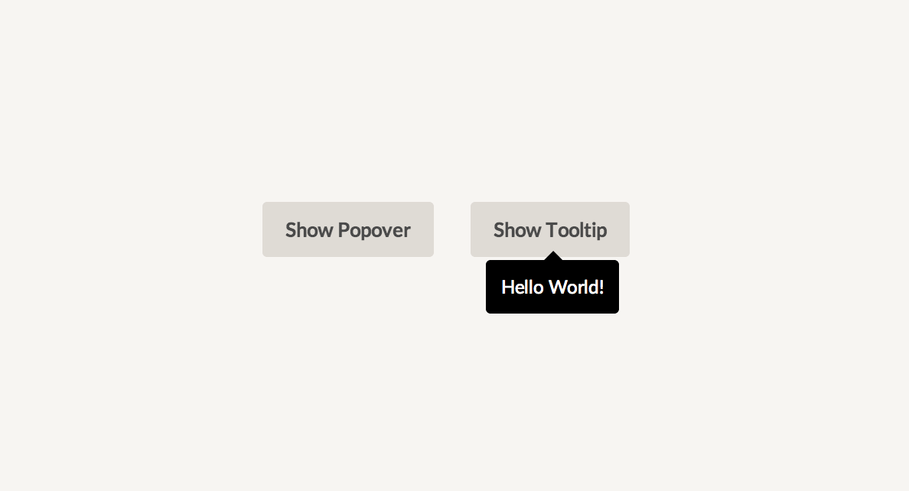
Tooltip
Used as a caption for images or buttons
Consider having a tooltip when you have ambiguous buttons that require captions
Usually used with Twitter Bootstrap

Slide 6
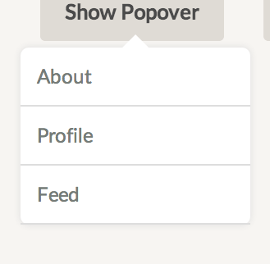
Creating Popovers & Tooltip
2 sections: Arrow & Content, stacked vertically.
Content is same old CSS… but what about the arrow?
Arrow
Content
About (Item Class)
Profile (Item Class)
Feed (Item Class

Slide 7
Triangle in CSS
Base
Set sides that are not base to <size> solid transparent
Set the base to <size> solid <color>
Set width and height to 0px
For the example:
Border-left: 5px solid transparent; Border-right: 5px solid transparent;
Border-bottom: 5px solid blue;

Slide 8
Hands-on: Popover & Tooltips

Slide 9
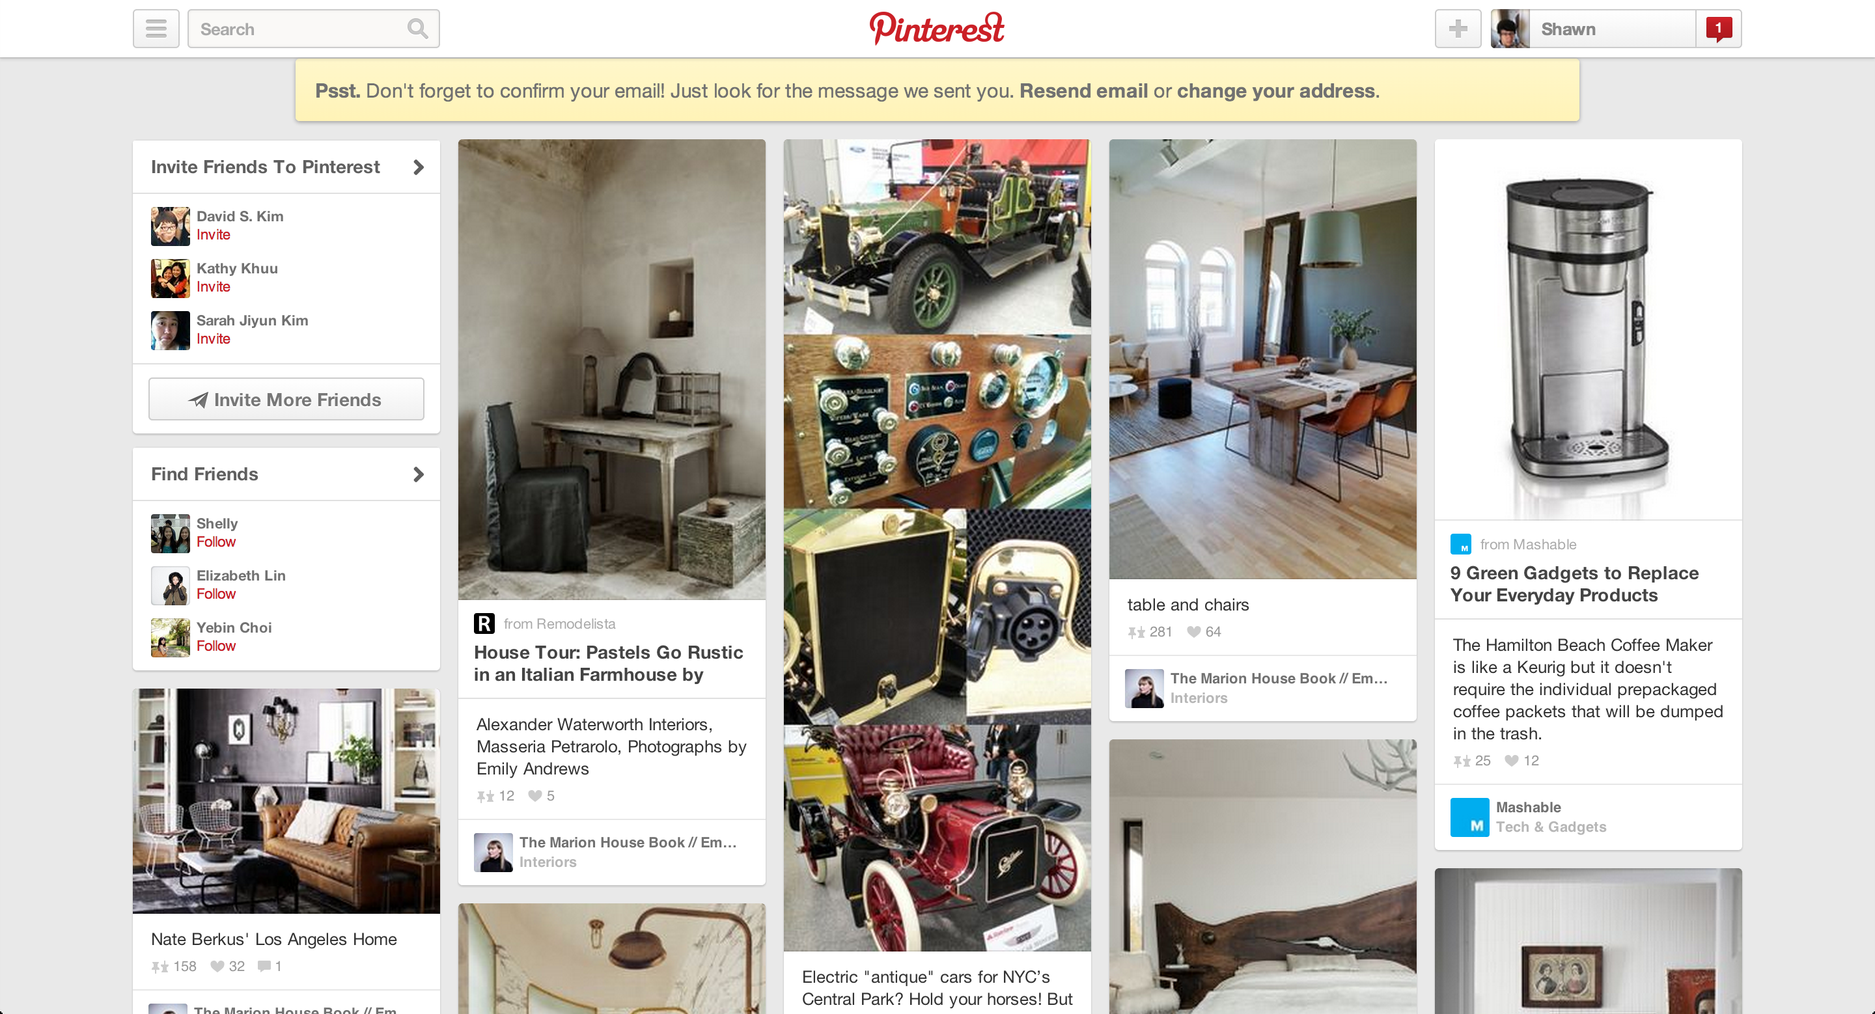
Masonry (Pinterest-style Grid)
Useful when building image-heavy websites
Allows you to preserve proportions of your images
Try not to use for text-heavy websites since it lowers readability

Slide 10
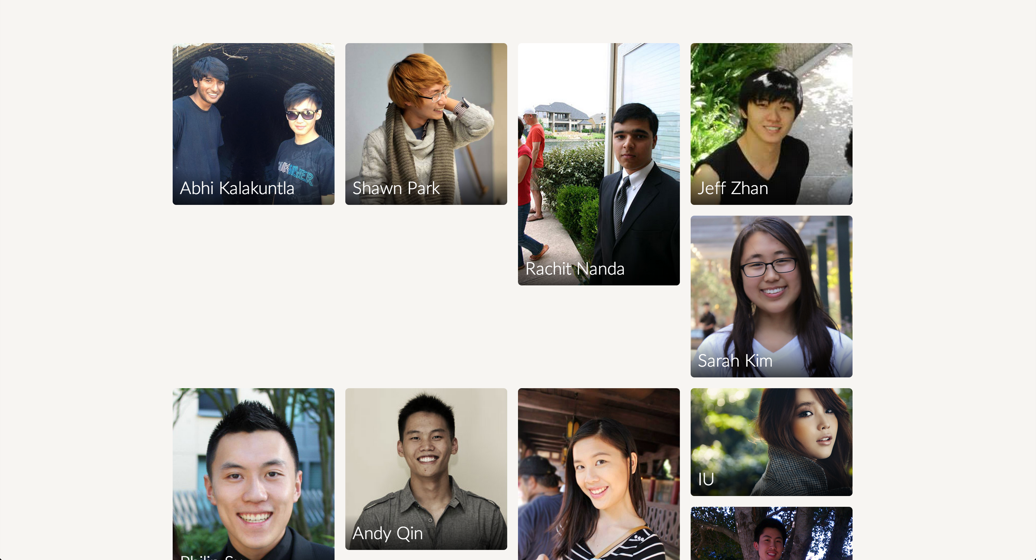
What happens when you float elements?

Slide 11
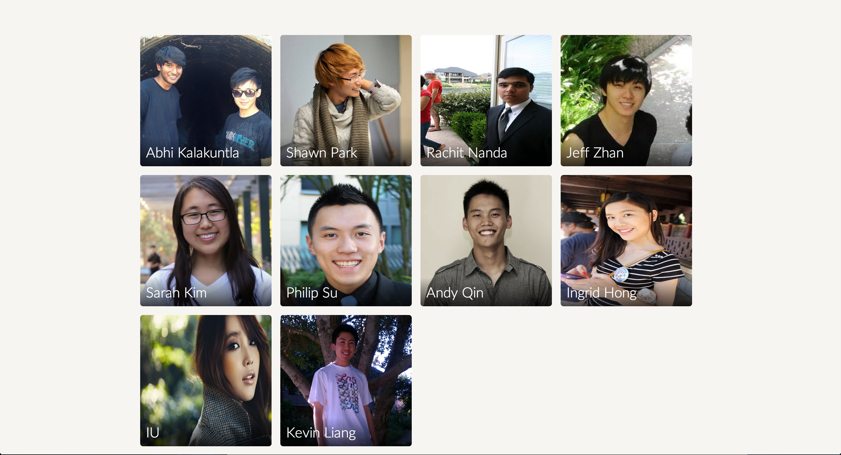
What happens when you enforce a fixed grid?

Slide 12
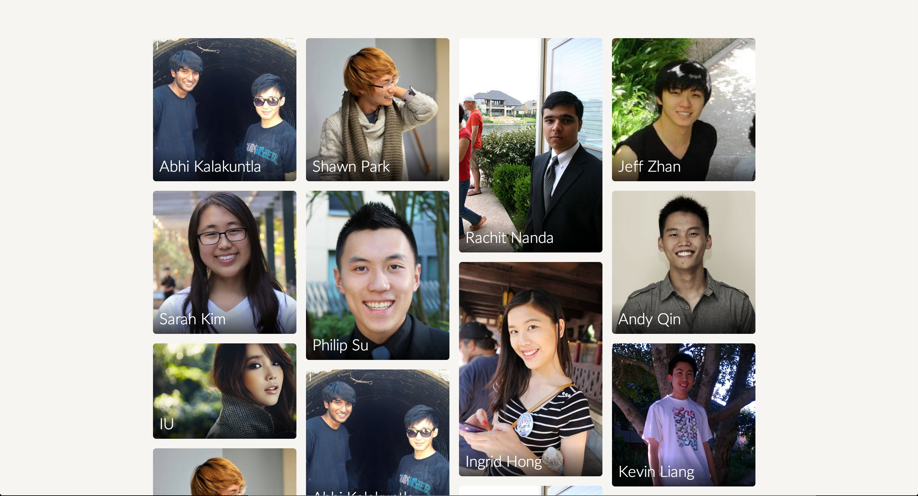
This is what we want

Slide 13
Jquery Masonry
Implemented using Jquery Masonry plugin
Automatically generates the position of the elements via position: relative on container and position: absolute on individual items

Slide 14
Sticky Nav
Navigation bar that starts off at the bottom of the page & sticks to the top when the user scrolls beyond certain position.
Popular for landing pages & one-page scroll websites
Combines the advantages of:
Emotional appeal from large cover photo
User Experience from immediate accessibility of navigation elements

Slide 15
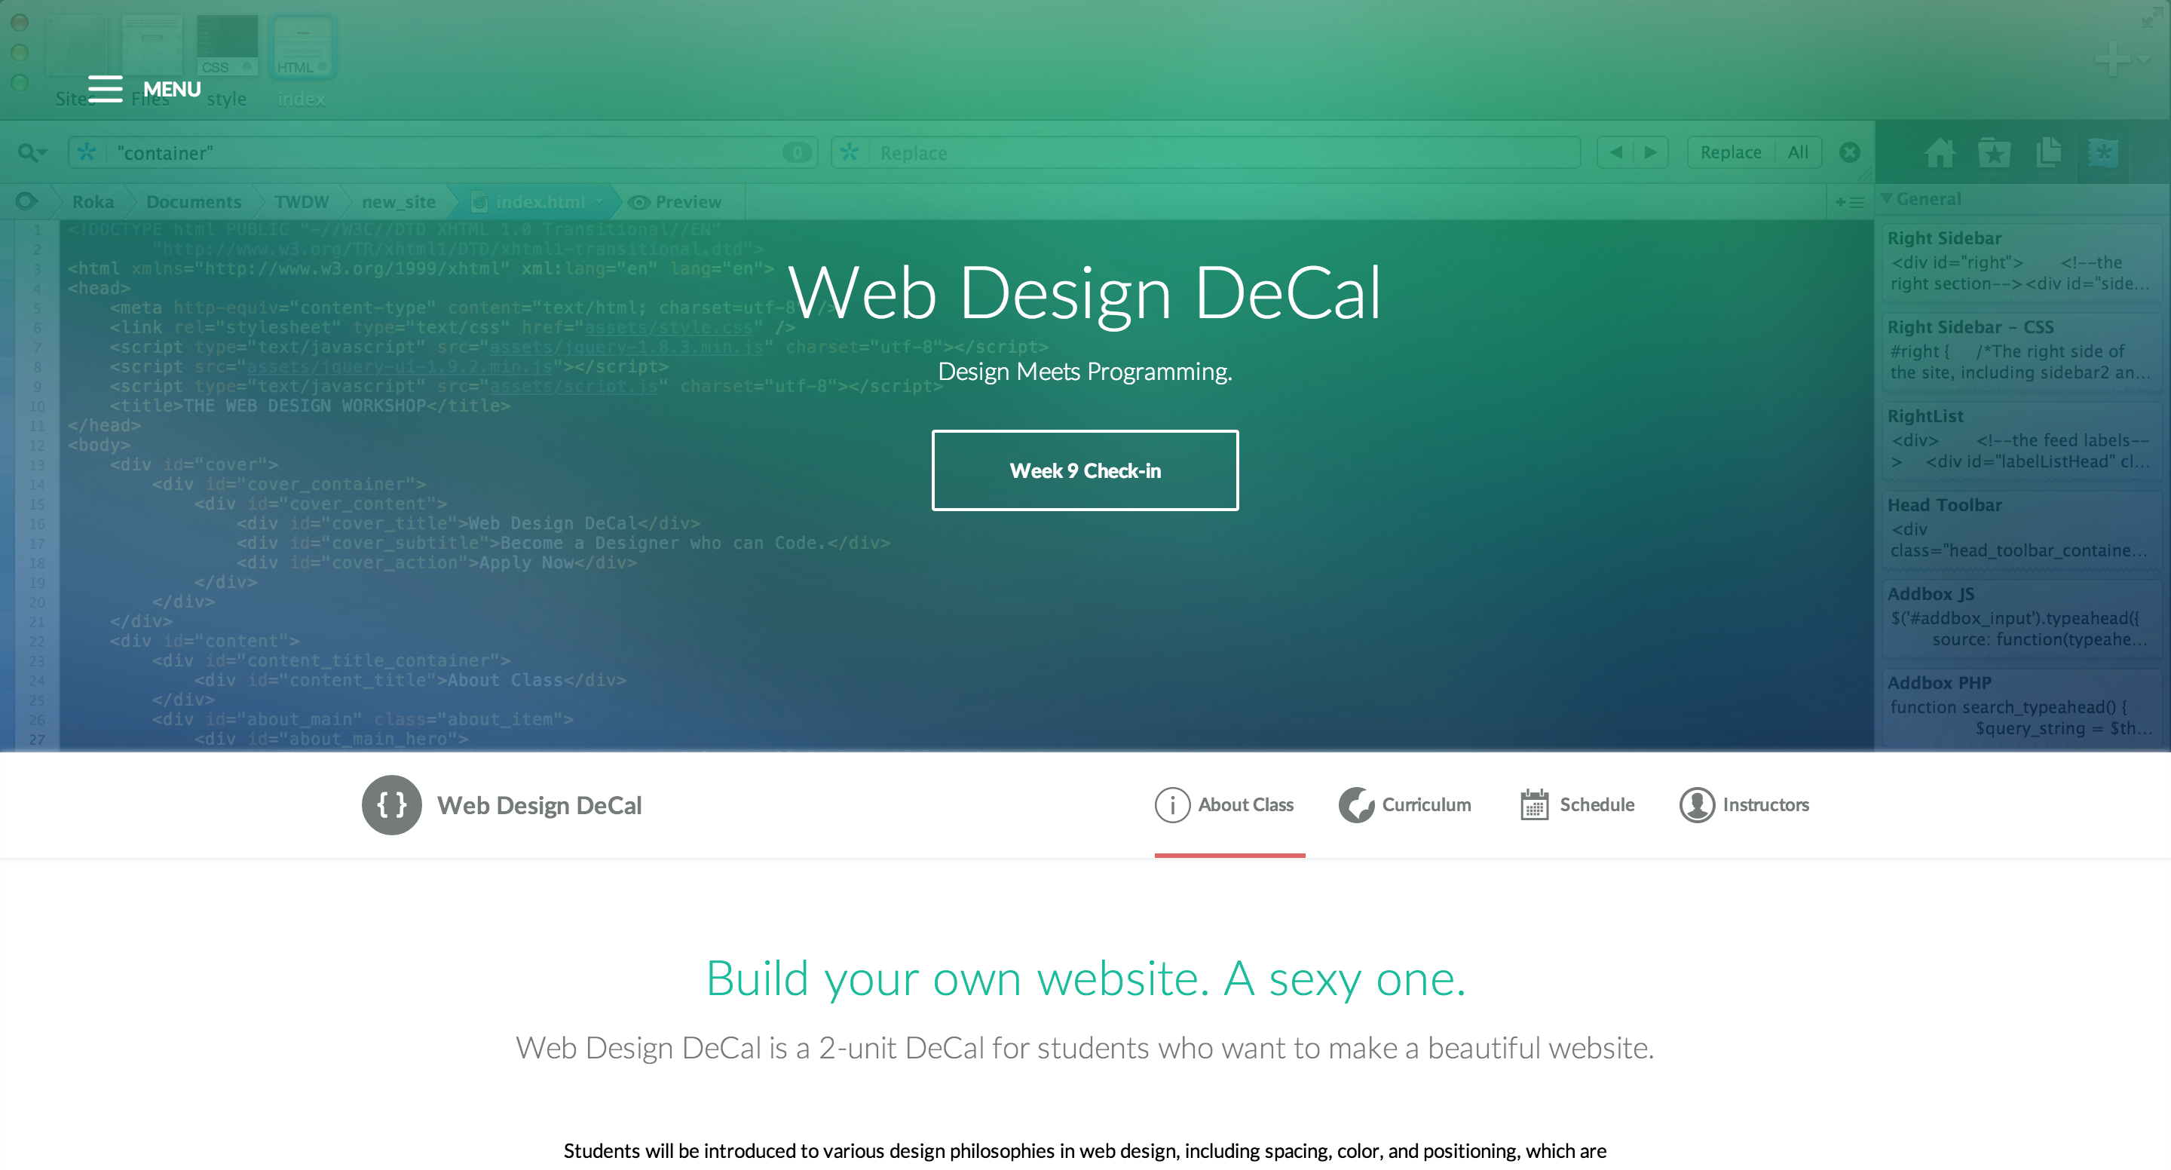
Navigation in original position

Slide 16
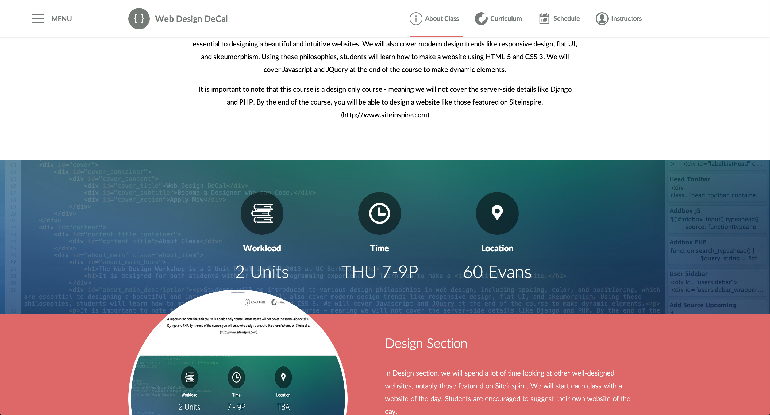
Navigation when the user scrolls past a certain position

Slide 17
Specifications for Sticky Nav
Navigation starts off at its original position
When the user scrolls beyond a certain position…
Make the navigation bar stick to the top.
When the user scrolls back up…
Put the navigation bar back to its original position
This can be formulated as if-else statement!
A few questions to answer:
How do we detect “scroll” event?
How do we make the navigation bar stick to top?

Slide 18
Hands-on: Sticky Nav

